Slide 1
Mobile Price Classification
BY
Akanksha Bhargavi – T00736533
Solomon mACCARTHY – T00734513
Viswateja ADOTHI – T00736529

Slide 2
Introduction
Mobile phones come in various models, each with different features and specifications.
Our analysis helps in understanding the diverse factors influencing mobile prices.
Target Population: Our target population is all available mobile phones in the market.
Sample size: Mobile phones released from 2012 to 2016.
Data Structure: The dataset includes both categorical data and continuous data.
CONTINOUS | CATEGORICAL
Battery Power | Four-g
RAM | Three-g
Internal memory | Dual sim
Pixel width
Pixel height
Primary camera

Slide 3
Data source: This dataset is collected from Kaggle.
Data cleaning : No “Missing” or “NA” values, hence not required.
Price range of mobile :
0 (low cost)
1 (medium cost)
2 (high cost)
3 (very high cost)

Slide 4
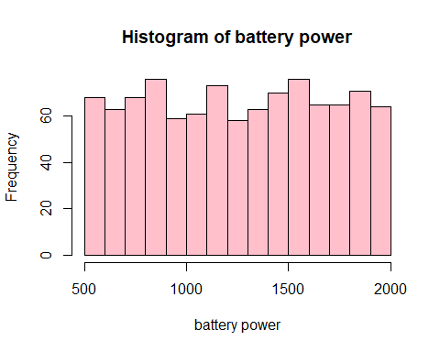
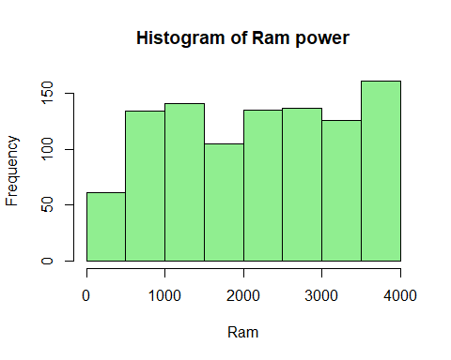
Distribution Analysis

Slide 5
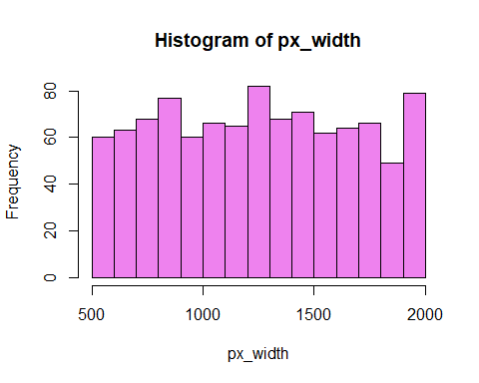
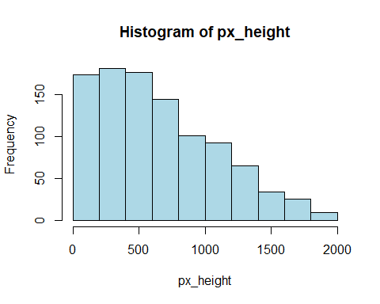

Slide 6
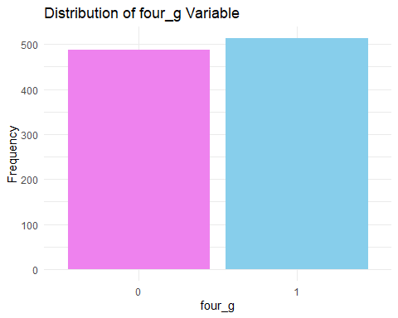
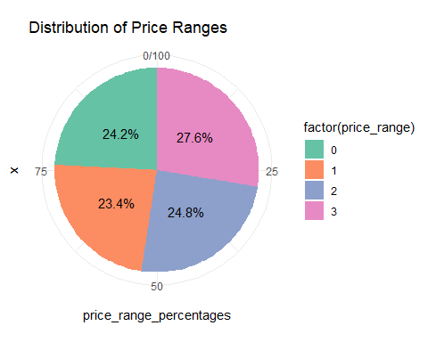
Distribution of Four g and Price range

Slide 7
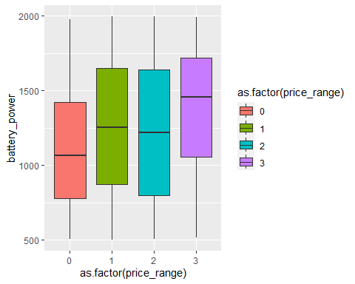
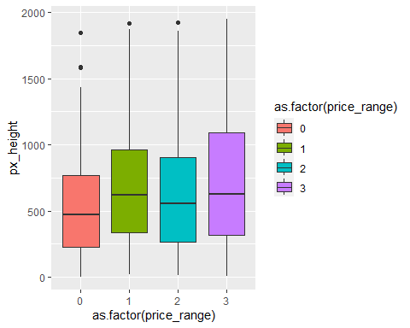
Boxplot Analysis : Price Range

Slide 8
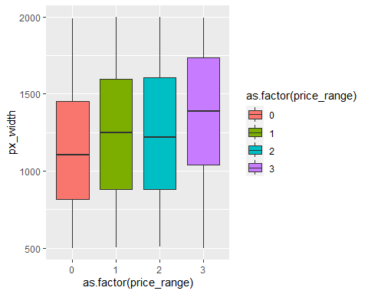
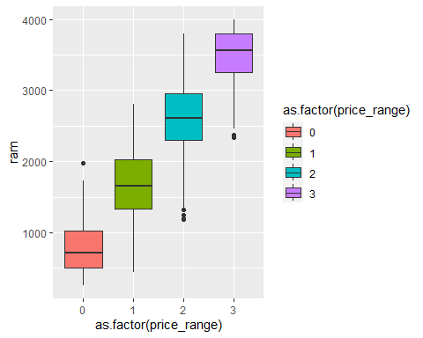

Slide 9
ANOVA Test:
Higher F-Value suggests larger difference between group means and is more significant
Lower p-value indicates higher level of significance
Here Ram has Higher F-Value and Lower P-Value which says there is strong association between independent variable(price range) and the dependent variable(RAM)
Feature | F-Value | P-Value
RAM | 5568 | <2e-16
Battery Power | 48.42 | 6.23e-12
Pixel width | 25.01 | 6.74e-07
Pixel height | 16.2 | 6.12e-05
Internal memory | 3.268 | 0.071
Primary Camera | 2.24 | 0.135

Slide 10
Hypothesis test
Test | Null Hypothesis (H0): | Alternative Hypothesis (H1): | Result
One Sample t-test | The average battery power of mobile phones in the population is equal to or less than 1238 mAh. | The average battery power of mobile phones in the population is greater than 1238 mAh. | 0.1466
Welch Two Sample t-test | There is no difference in the average battery power between phones with and without 4G. | There is a significant difference in the average battery power between phones with and without 4G. | 0.02489
Welch Two Sample t-test | There is no difference in the average RAM between phones with and without dual SIM | There is a significant difference in the average RAM between phones with and without dual SIM. | 0.03928

Slide 11
Pearson's Chi-squared test
Null Hypothesis (H₀): | Alternative Hypothesis (Hₐ): | P-value
There is no significant association between the 'Three_G' variable and 'Price_Range' in the population. | There is a significant association between the 'Three_G' variable and 'Price_Range' in the population. | 0.2994
There is no significant association between the 'Four_G' variable and 'Price_Range' in the population. | There is a significant association between the 'Four_G' variable and 'Price_Range' in the population. | 0.1713

Slide 12
Conclusion
Higher RAM, larger battery power, and better camera specifications could contribute to higher price ranges.
Whereas primary camera and internal memory may not be strong indicators of differences in mobile phone prices.
The network type alone may not be a strong predictor of price range.
The dual SIM phones may have different RAM specifications compared to single SIM phones.
4G capability may be a factor influencing the battery power specifications of mobile phones.

Slide 13
THANK YOU

